Slide 1
Overview of System Software & Text Editors
Presented by: Foram Thakor

Slide 2
Overview
Introduction to System Software
Characteristics of Software
Software Hierarchy
System Programming
Lifecycle of a Source Program
Levels of System Software
Text Editors
User Interface
Types of Text Editors

Slide 3
What is a Software?
It typically refers to programs or applications that directly manage the hardware resources of a computer system and provide a platform for running other softwares.
In a formal definition, Computer software, or simply software, is a generic term that refers to a collection of data or computer instructions that tell the computer how to work.
It can be better understood by an example, imagine your house is a big computer and software acts as the foundation and structure that holds everything.

Slide 4
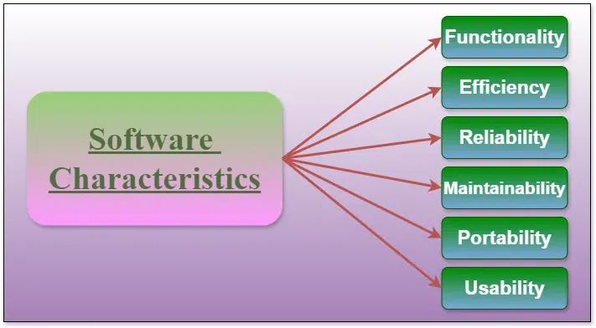
Characteristics of a Software

Slide 5
Characteristics of a Software
Functionality: This refers to what the software can do or the tasks it can perform.
Reliability: performs consistently and predictably under various conditions.
Efficiency: utilizes system resources (such as CPU, memory, and storage) effectively and minimizes resource usage while achieving its intended functions.
Usability: is easy to understand, navigate, and operate, even for users with varying levels of expertise.
Maintainability: is easy to modify, update, and extend over time.
Portability: can run on different hardware platforms or operating systems with minimal or no modifications.

Slide 6
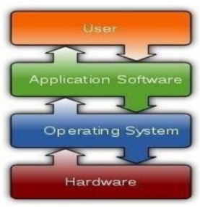
Software Hierarchy

Slide 7
Software Hierarchy (Contd.)
Application software
Software that uses the computer system to perform special functions or services or provide entertainment functions beyond the basic operation of the computer itself (example: word processor)
System software
Software that directly operates the computer hardware, to provide basic functionality needed by users and other software, and to provide a platform for running application software. System software includes software categories such as operating systems, utility software, device drivers, compilers, and linkers.

Slide 8
System Software Includes:
Operating systems
which are essential collections of software that manage resources and provides common services for other software that runs "on top" of them.
Device drivers
which operate or control a particular type of device that is attached to a computer. Each device needs at least one corresponding device driver; because a computer typically has at minimum at least one input device and at least one output device, a computer typically needs more than one device driver.

Slide 9
System Programming
System programming aims to produce software and software platforms that provides services to the other software or computer hardware (example: OS, device drivers, utility software).
The essential characteristics of system programming are as follows:
1. Programmers are expected to know the hardware and internal behaviour of the computer system on which the program will run. System programmers explore these known hardware properties and write software for specific hardware using efficient algorithms.
2. Uses a low-level programming so that programs can operate on source-constrained environment.
3. These are very efficient programs with a small or no runtime library requirements.
4. Has access to systems resources, including memory
5. System programs can be run in simulated environment

Slide 10
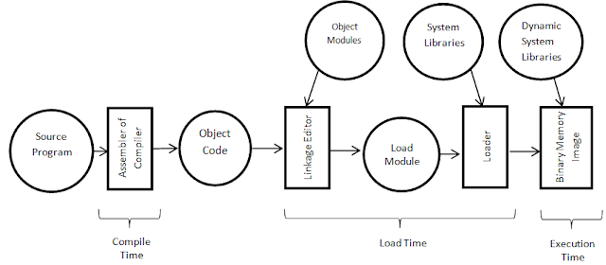
Lifecycle of a source program
The life cycle of a source program defines the program behavior and extends through execution stage, which exhibits the behavior specified in the program.

Slide 11
Lifecycle of a source program (Contd.)
Every source program goes through a life cycle of several stages.
Edit time: It is the phase where editing of the program code takes place and is also known as design time. At this stage, the code is in its raw form and may not be in a consistent state.
Compile time: At the compile time stage, the source code after editing is passed to a translator that translates it into machine code. One such translator is a compiler. This stage checks the program for inconsistencies and errors and produces an executable file.
Distribution time: It is the stage that sends or distributes the program from the entity creating it to an entity invoking it. Mostly executable files are distributed.

Slide 12
Lifecycle of a source program (Contd.)
Installation time: Typically, a program goes through the installation process, which makes it ready for execution within the system. The installation can also optionally generate calls to other stages of a program's life cycle.
Link time: System libraries are linked by using the lookup of the name and the interface of the library needed during compile time or throughout the installation time, or invoked with the start or even during the execution process.
Load time: This stage actively takes the executable image from its stored repositories and places them into active memory to initiate the execution. Load time activities are influenced by the underlying operating system.
Run time: This is the final stage of the life cycle in which the programmed behavior of the source program is demonstrated.

Slide 13
Levels of System Software
The levels of system software refer to the hierarchical stages or layers within system software architecture, each responsible for different functions and providing varying degrees of abstraction and interaction with the underlying hardware and application software.
These levels typically include the firmware, operating system kernel, system libraries, and system utilities.
Level refers to the specific tier or scope within a system where analysis, design, or operations take place. It can range from high-level (abstract, broad scope) to low-level (detailed, narrow scope) perspectives.

Slide 14
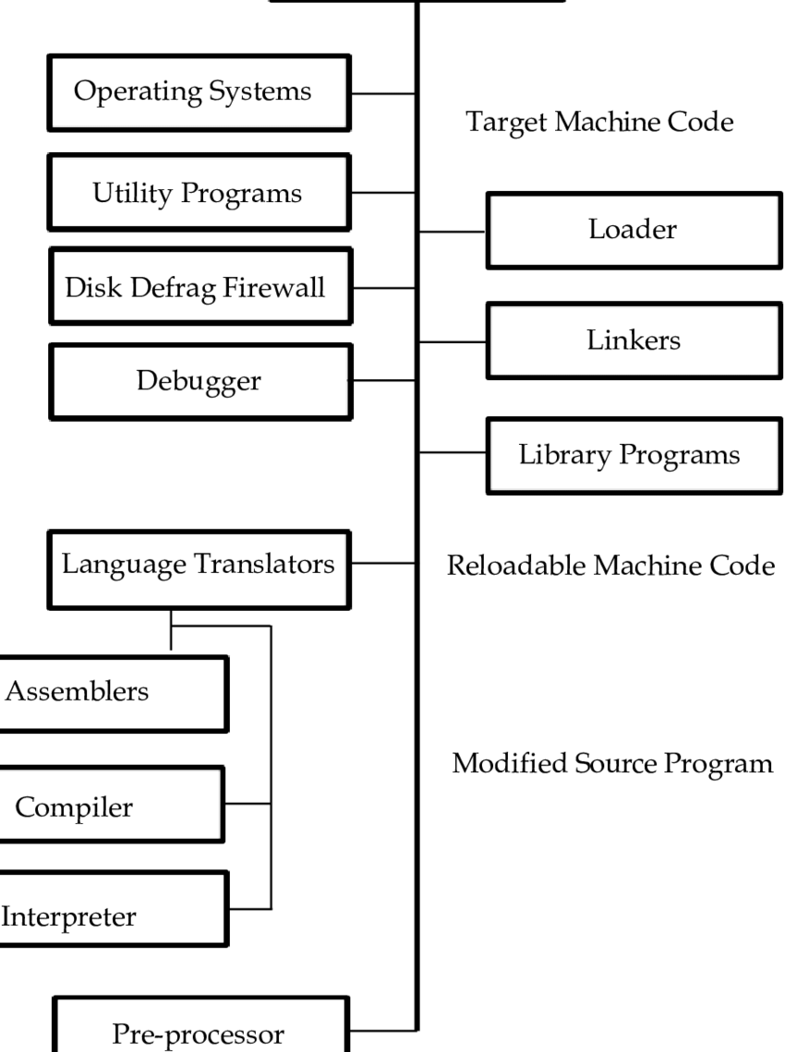

Slide 15
Text Editors
A text editor is considered a primary interface for all types of workers as they compose, organise, study and manipulate computer based information.
The term document includes objects such as computer program, text, equations, table, diagram and almost anything that can appear on a printed page.
Text editors range from simple tools for basic text editing to sophisticated environments for code development.

Slide 16
Overview of editing process
The editing process is essential for refining and improving text, whether it's for writing, programming, or document preparation.
Select the path of the target document to be viewed and manipulated.
Determine how to format this view on-line and how to display it.
Specify and execute operations that modify the target document.
Update the view appropriately.

Slide 17
Overview of editing process
Editing phase involves how the target document is created or altered with a set of operations such as insert, delete, replace, move and copy.
A manuscript-oriented editor might operate on element such as single characters, words, lines, sentences and paragraphs.
A program-oriented editor might operate on elements such as identifiers, keyword and statements.

Slide 18
User interface
User interface allows interaction between a software and a user by providing various modalities of interaction including graphics, sound, position, movement, etc.
These interfaces facilitate transfer of data between the user and the computing system.
User interface is very important for all systems that require user inputs.
A well-designed user interface in a text editor enhances usability, productivity, and user satisfaction.
Visual Studio Code (VS Code) is a prime example of a text editor with an excellent UI, combining functionality, customization, and ease of use.

Slide 19
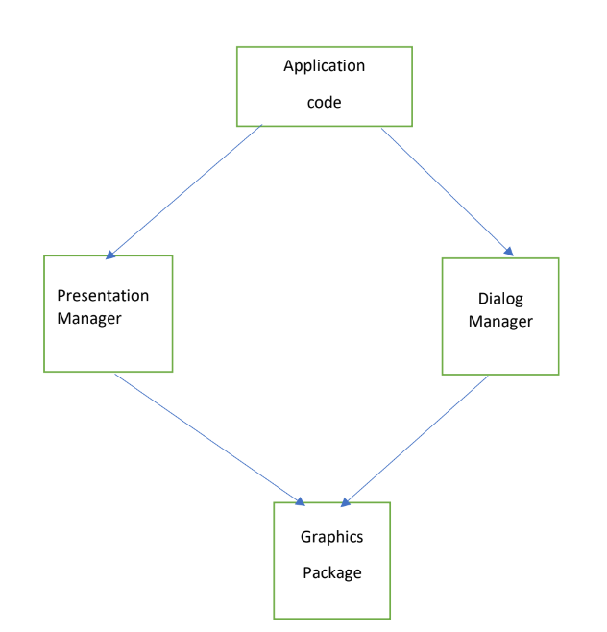

Slide 20
Structure of User Interface
Dialog Manager | Presentation manager
The dialog manager manages the conversation between the user and the application. This involves prompting the user for the command and transmitting the command to the application. It is also responsible for interpreting user commands and implementing them by invoking different modules of the application code. It is also responsible for error messages and online help function. | The presentation manager displays the data produced by the application in appropriate manner on the user’s display. It is also responsible for managing the user’s screen and for accepting data and presentation results.

Slide 21
Types of Text Editors
Line-by-line Editor
Line-by-line editors are a type of text editor where the user interacts with the text one line at a time.
These editors are typically used in command-line environments and are often preferred for their simplicity and efficiency in certain scenarios, such as quick edits on remote servers.
Users can edit, delete, or insert lines of text one at a time.
Often used for quick edits or scripting tasks.
Generally less intuitive for complex editing compared to modern text editors.
Examples: ed(for Unix-based systems), sed(Stream Editor)

Slide 22
Types of Text Editors
2. File-Oriented Editor (WYSIWYG)
File-oriented text editors allow users to interact with the entire file as a whole, providing a more comprehensive and visual interface for text editing.
These editors are generally more user-friendly and suitable for more complex editing tasks, including coding, writing, and document preparation.
Users can see and edit multiple lines or the entire file at once.
Often include advanced features such as syntax highlighting, search and replace, and multi-file editing.
Provide a more intuitive interface for complex tasks.
Examples: Notepad++, Visual Studio Code (VS Code), Emacs, Vim

Slide 23


